Slide 1

Time Complexity

Slide 2
Table of Contents
1
Compile Time Vs Run Time
2
What is Time Complexity?
3
What are the cases your code may face?
4
Notations for Time Complexity
5
Rules for Time Complexity
6
Problems & Examples

Slide 3

01
Compile Time VS Run Time

Slide 4
Compile Time VS Run Time
Compile Time
Run Time
The time it takes to translate your code into machine-readable instructions.
The time it takes for your program to execute after compilation.

Slide 5



Compiling Time & running Time

Slide 6
02
What is Time Complexity ?

Slide 7
How does the running time change as the size of input change ?
Input
Time

Slide 8
03
What are the cases your code may face?

Slide 9












Best Case
Target = 7
7
2
6
5
1
9
4
Step = 1
Average Case
Target = 5
7
2
6
5
1
9
4
Step = 4
Worst Case
Target = 4
7
2
6
5
1
9
4
Step = 7

Slide 10
04
Notations for Time Complexity

Slide 11



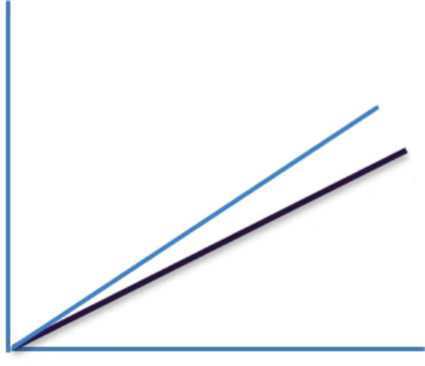
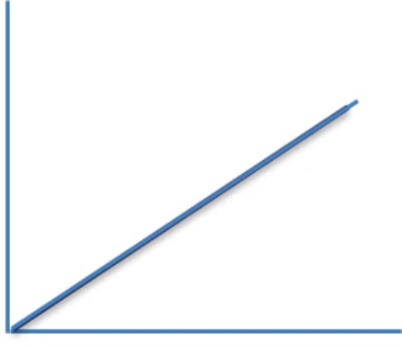
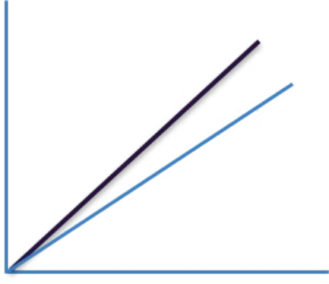
"Omega"
"Theta"
"Big O"
the lower bound of the time.
the bound itself.
the upper bound of the time.

Slide 12

Rules?
05

Slide 13
Rules
1
Running time is the sum of running times of all consecutive blocks.
2
Nested loops are multiplied.
In general -> Nested repetitive Blocks are multiplied.
3
In Conditional statements pick the "Worst case" one.
4
Drop Constants (addition, subtraction, multiplication or division).
5
Drop all lower order terms.

Slide 14
06
Problems & Examples

Slide 15
—مكتوبة في الجيم اللي عندي
"A champion is someone who gets up when they can't."

Slide 16
Resources
https://www.youtube.com/watch?v=o5zf5oVHtn0&list=PLw2JSXGww1ORU9v3h8jBS_bNz-ngSW2wk&index=2
https://youtu.be/krRT_US9Ll0?si=9Vj4mPUviTORRMfr
https://www.w3schools.com/dsa/dsa_timecomplexity_theory.php

Slide 17


The End

